Slide 1

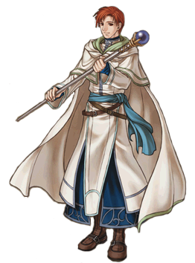
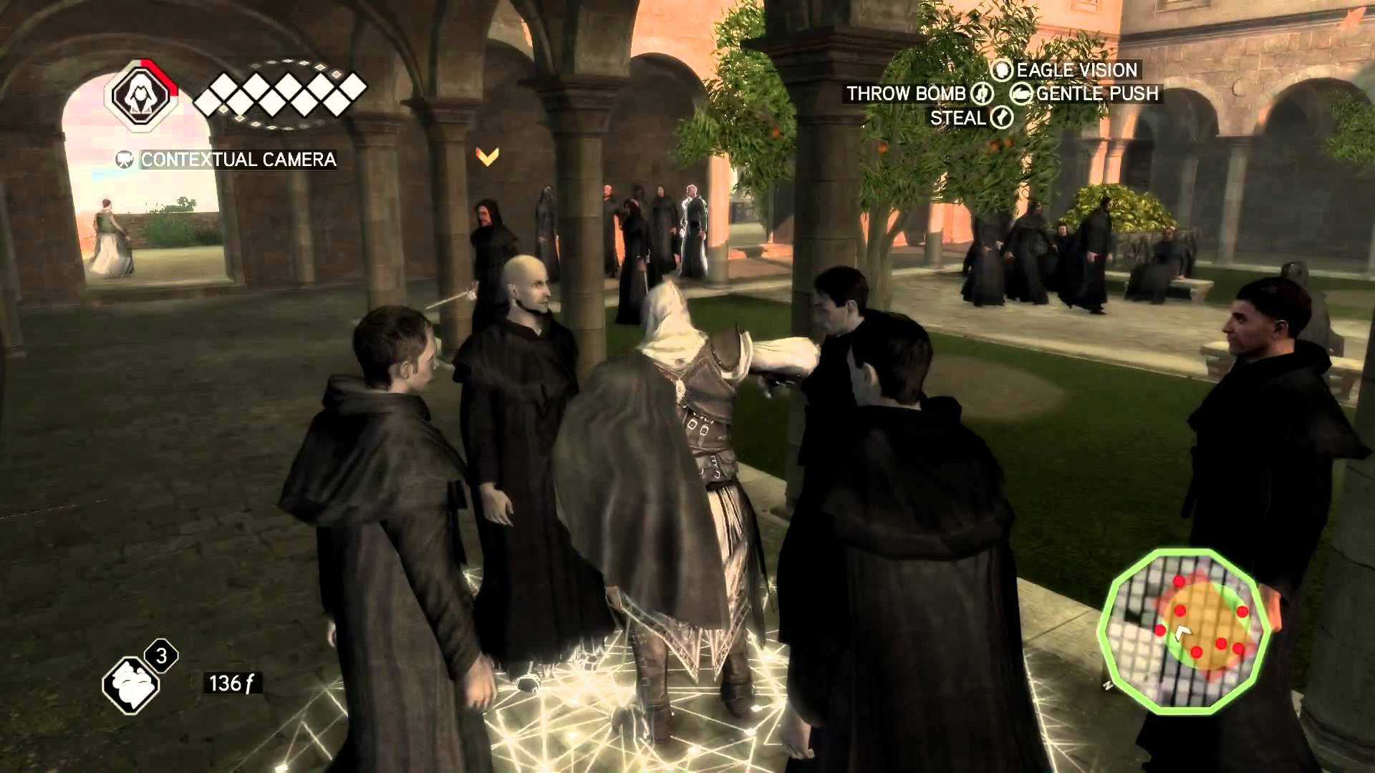
Monks and Video Games? .

Slide 2
Cluny: The Game
By Allison Kuhl

Slide 3
Can Video Games be Good History?

Slide 4
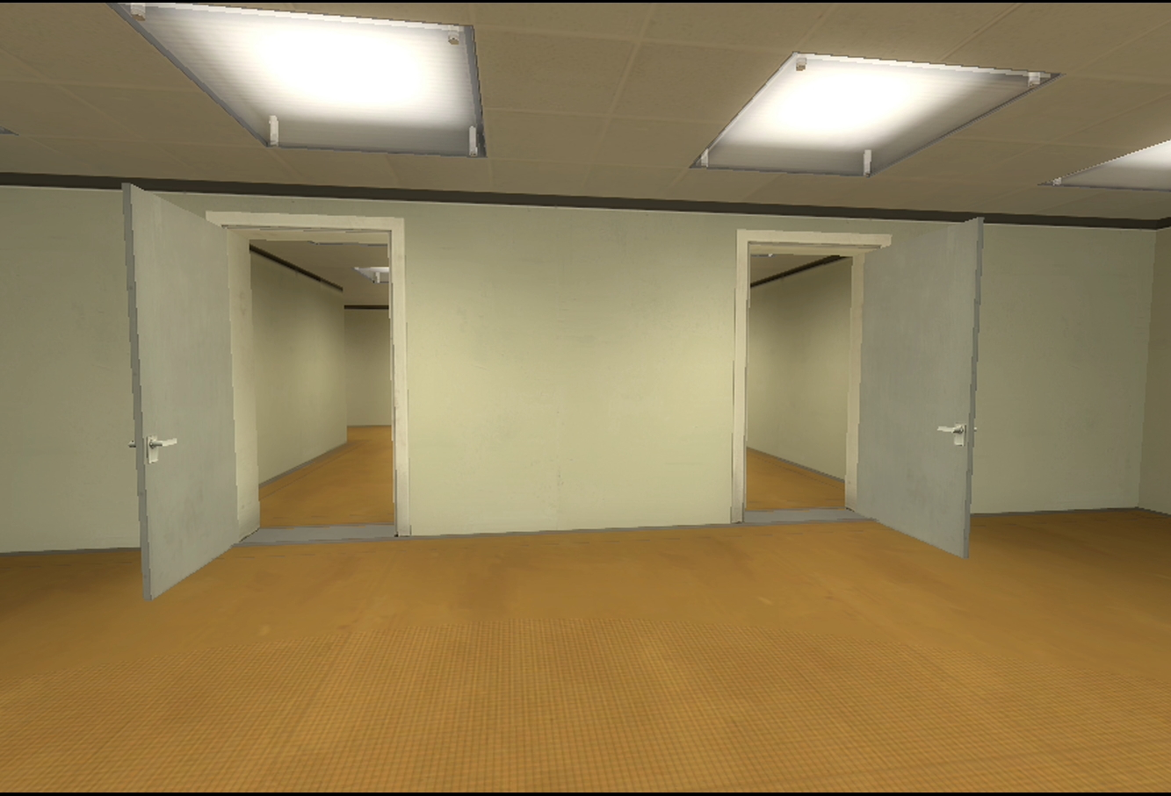
The Power of Choice
Games have choices
History is not inevitable
Players construct their own historical narrative
Hmm….Which door to take?

Slide 5
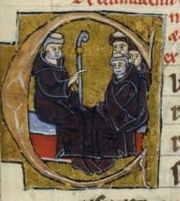
A Monk is You
‘Cultural Models’ – James Gee
We are forced to inhabit the role of a medieval person, and thus act in a way we might personally would not
Gets us into the worldview of a monk
YOU

Slide 6
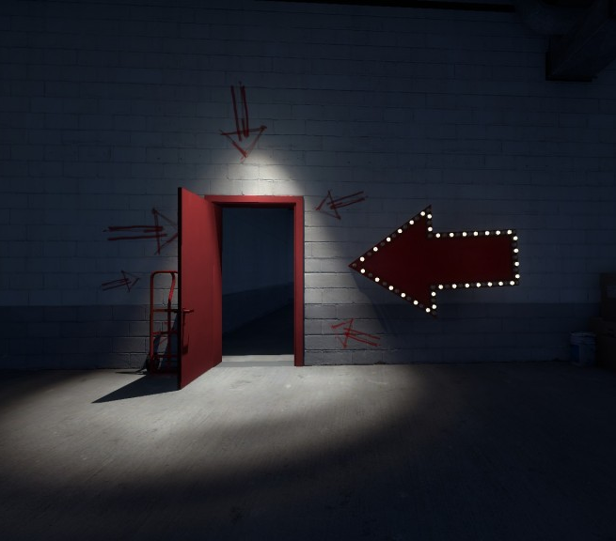
The Illusion of Choice
But games are determined as much as what you can’t do as what you can do
You are ultimately controlled by the algorithms of the game
Hmm.. which door should I take?

Slide 7
Procedural Rhetoric
Coined by Ian Bogost for the idea that the processes of a game can be persuasive
How the game is played, i.e. the structure of a game, is just as important as the games content
The structure of a game makes arguments

Slide 8
And so...
What games teach best is how to play the game
By rewarding or punishing certain actions, you are taught how to act
My game aims to teach you how to live by the ideal standards of a monk

Slide 9
Cluny: the Game
You will play as an aristocrat living near Cluny in the 12th century
You decide:
Male vs Female
Adult convert vs. Oblate

Slide 10
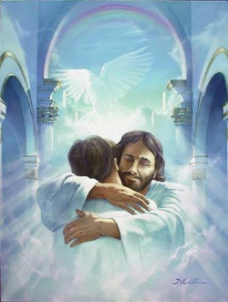
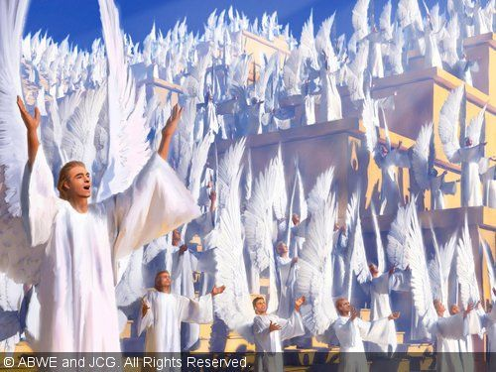
Possible Endings
BEST Ending
You go STRAIGHT to heaven when you die
Only for people without sin

Slide 11

Possible Endings
Pretty Nice Ending
You get to heaven pretty quickly, although you do have to wait a bit while people pray for you
For the average monk
Or if you were an amazing lay person who donated a lot of money to the church

Slide 12
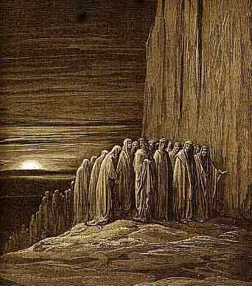
Possible Endings
Meh Ending
You get to heaven eventually, but it takes a pretty long time
If you did a lot of bad things in life, but then repented and became a monk later
If you didn’t confess all your sins properly or something like that

Slide 13
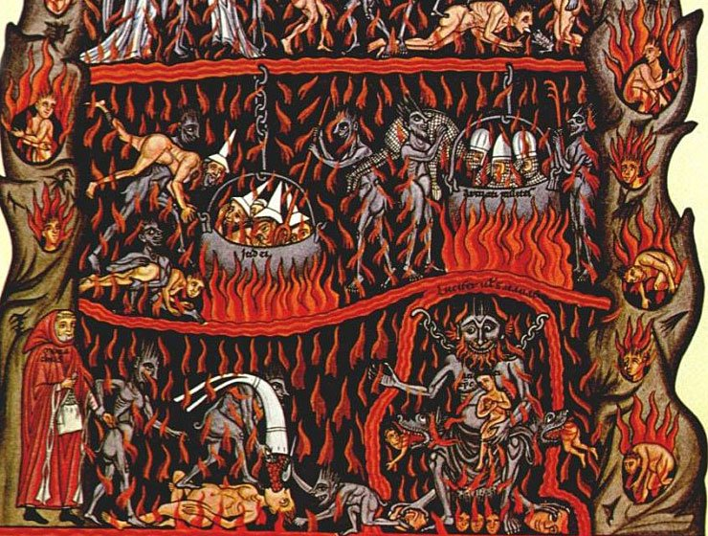
Possible Endings
Worst Possible Ending
It’s Hell!
If you looted Cluniac property, or if you consistently disobeyed the rule and committed many terrible sins
There will be much weeping and gnashing of teeth

Slide 14
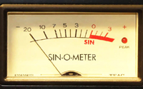
Sins
How many times you sin will be kept track of on the screen at all times
Once you confess your sins, they will go to a ‘penance meter’ which you will have to work off by prayer or whatever
If you still have penance when you die, you’ll have to wait while people on earth prayer for you, gradually decreasing your penance meter.

Slide 15
Every-Day Dilemmas
Throughout the game, you will encounter everyday dilemmas that you will have to deal with.
For example, waking up each morning. Do you sleep in longer or get up right away?
Or going to bed: Do you go to sleep, or stay up late doing extra prayers?

Slide 16
Special Dilemmas
There will also be more unusual dilemmas which will be randomly generated at certain points
For example, a visiting abbot might come and try to get you to leave the monastery. Do you go, or don’t go?
If you are especially holy, your fellow monks might try and falsely accuse you of things. What do you do?
You might encounter demons in the monastery. What do you do?

Slide 17
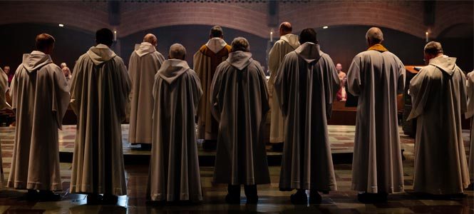
Prayer
An important part of monastic life
How to implement it into a game?

Slide 18
Platform
Twine
http://twinery.org/
Text-based, simple

Slide 19
Problems
Entertainment Value
Would a game about monks be entertaining?
Should it be entertaining?
How can we make a game that is both educational and engaging?

Slide 20
Problems
Scope
Like any work of history, a video game must make choices as to what to include and what not to include.

Slide 21
Problems
Time and Ability
An ‘ideal game’ would have amazing graphics in a perfect 3D reconstruction of Cluny, with super advanced gameplay and hundreds of different possibilities and endings
But that’s probably not going to happen.

Slide 23

Everything is a Game!
‘the game of life’
How do we win?
School as a game
A monastery as a game?

